Slide 1




Paper Craft AI
An ML Paper Recommendation System
Vishnu Priya Thanda
Under the guidance of: Dr. Chaojie (Jay) Wang
UMBC
For People who love researching and reading

Slide 2



Outline
Background
Data Collection
EDA
Implementation
Embedding Models
Demo
Conclusion

Slide 3

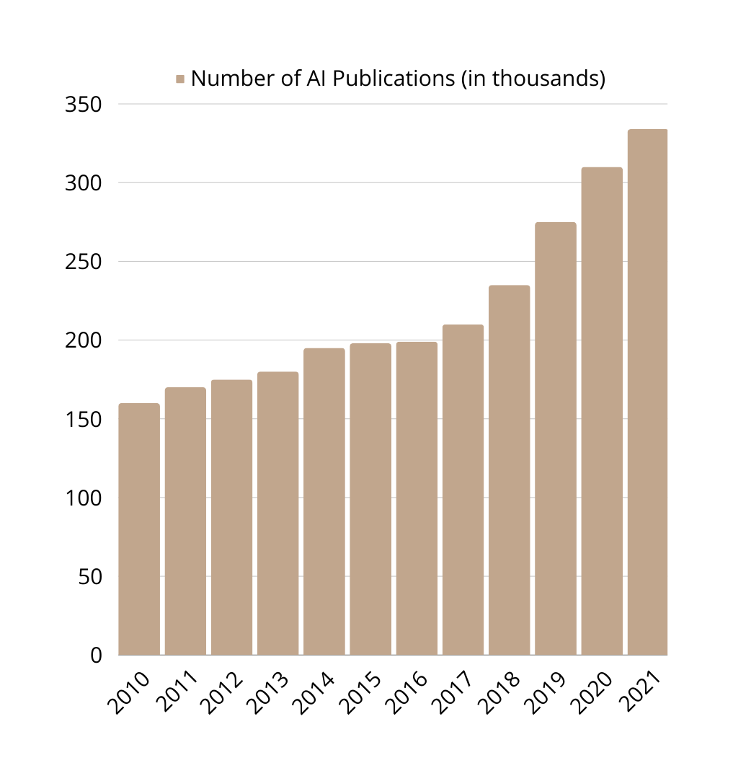

25%
Number of AI Publications (in thousands)
75%
Year
Source: https://aiindex.stanford.edu/ai-index-report-2022/

Slide 4





Data Collection
API
Extracted data from arXiv API
9500 Machine Learning Papers
Each paper has data about summary, title, authors and link to the paper.
Collected Data

Slide 5


Sample Data
Id | Title | Summary | Authors | Published | Link
1 | A Market-Oriented Programming Environment and | Market price systems constitute a well-under... | M. P. Wellman | 2022-08-08 | http://arxiv.org/abs/cs/9308102v

Slide 6
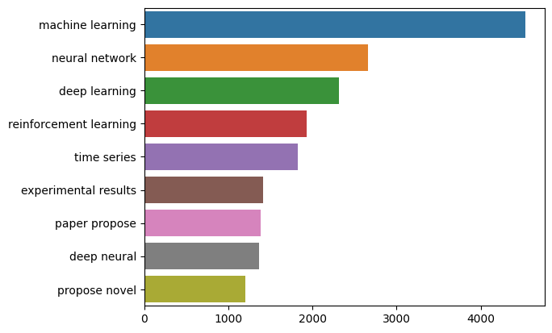
EDA
Top Bi-Grams of the Summary
Bi-Grams
Frequency of Bi-Grams

Slide 7
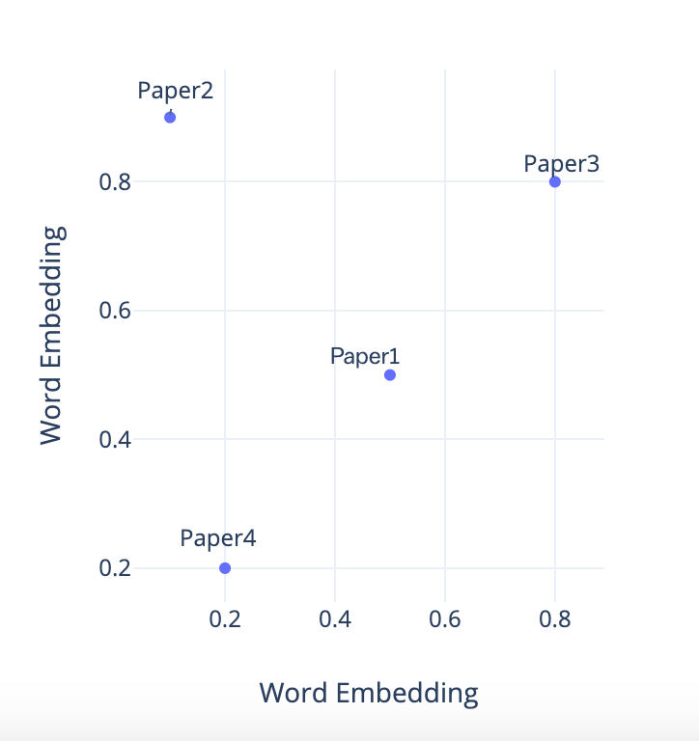
Word Embeddings Models
Tf-IDF
Sentence Transformers
Specter 2.0 (Bert Based)

Slide 8
System
Select a paper/ Search for a Paper
Paper Details
Paper1
Paper2
Paper 3
Paper 4
Paper5

Slide 9
Demo

Slide 10
Conclusion
Recommendation tool helpful for research.
Collaborative Filtering based on the user interactions.
Try multiple new embedding models like ada from OpenAI.

Slide 11

THANK YOU

